Slide 1
Practicum Preceptor Orientation
2023

Slide 2
Introductions
General:
Bridget Mavety (MavetyB@camosun.ca)
Cardiac:
Kendal Adam (AdamK@camosun.ca)

Slide 3
Clinical Liaison Role
Point of contact between clinical supervisors/preceptors and Camosun College
Review all student reflections, technologist feedback forms and formal evaluations
Formal check-ins with students every 4 weeks (general – in person clinical site visits, cardiac – online)
Attends Island Health/Camosun College Working Group meetings where Clinical Skills Labs and Practicum progress is discussed

Slide 4
Preceptor Role
Point of contact between clinical sites and Clinical Liaison
  Please email us if there are any questions/comments/concerns – the earlier the better!
Provide supportive and constructive feedback on all student reflections, technologist feedback forms and formal evaluations
CCSA assessor
  Reminder: you need to have completed the Sonography Canada CCSA Assessor Tutorial in order to be able to “sign off” on these cases

Slide 5
Clinical Practicum Logistics
January 10th – April 20th (15 weeks)
  Remediation week April 25-28
    If a student misses more than 2 days of clinical, minimum Portfolio or CCSA completion is not met, not maintaining reasonable progress
Tuesday – Friday (with the exception of 1 RJH evening rotation)
  Monday is their academic day
7.5hr days
  Supervisors/preceptors will give the students their shift times with the most amount of notice possible

Slide 6
Clinical Skills Labs vs. Practicum
Students have been rotating out to the Victoria sites since Term 2 of the program (this is Term 6)
Term 2: 4 hours/week in the general department
Term 3,4,5: 8 hours/week in both the cardiac and general departments
This is their first “traditional” practicum (4 days/week)

Slide 7
Clinical Skills Labs vs. Practicum
During the Clinical Skills Labs, students were working on “mini skills” which should have taken 5 minutes (ie. instead of a full abdomen, the student would scan the liver)
A lot of students are able to complete entire exams for the exam types that they have had more practice in (ie. abdomens, OB1, pelvises, thyroids)
Due to lack of exposure during clinical, there have been some skills that may be more behind than others – students will communicate this to their preceptors (ex. OB2, OB3, scrotums, vascular)
In practicum, students will be working towards completing their CCSA in which they will scan the entire exam
Students can be under INDIRECT supervision only when the preceptor deems that the student is ready for this
  At the start of the term, students will need to be under DIRECT supervision (the preceptor being present for ALL student-patient interaction)

Slide 8
Importance of Timely Feedback
Please reach out to the Clinical Liaisons if there are ANY concerns
If there are significant concerns, a Learning Contract can be implemented to ensure the student has additional support and can be successful
Supervisors often want to be looped in as well, ask your supervisor for what level of involvement they would like
The Sonography Clinical Coordinator should also be made aware of any significant concerns

Slide 9
Clinical Portfolio
Students will bring their Portfolios with them on their first day
The portfolios will NOT contain any patient information so that the student can bring their own Portfolio with them when they rotate sites
  Instead of Accession numbers, students will record the date/time/type of examination so that the case can be found easily if necessary
Daily log of cases, technologist feedback forms, bi-weekly reflections, evaluations
Sonography Canada CCSA manual
These need to be stored in a secure/locked area

Slide 10
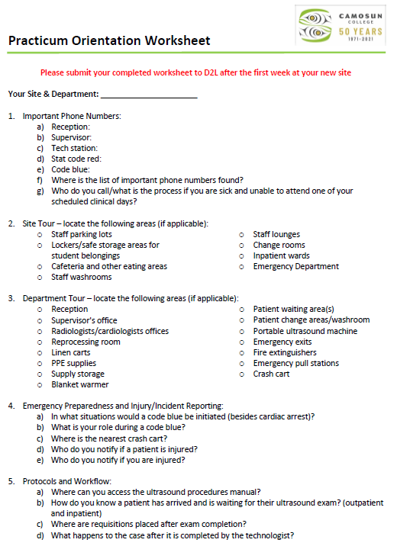
Assignments:
Orientation
Due at the end of the first week at a new site
Department tour
Safety questions
Daily workflow questions

Slide 11
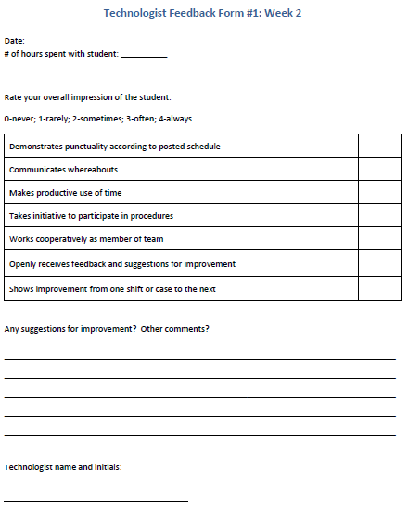
Assignments:
Technologist Feedback Forms
Bi-weekly (weeks 2,4,6,8,10,12,14)
Acts as a check-in with student
Please provide suggestions for improvement and comments

Slide 12
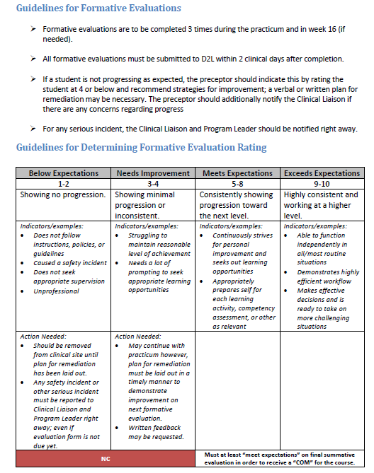
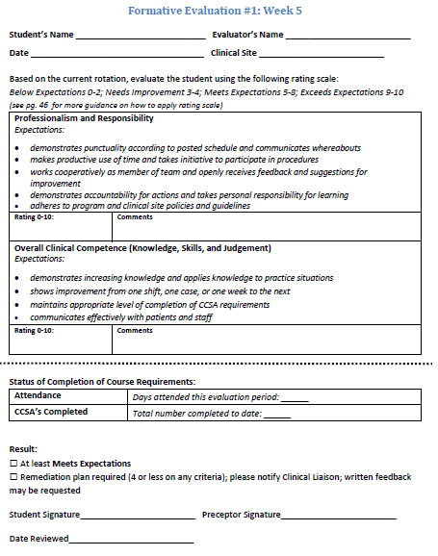
Assignments:
Formative Evaluations
Formative evaluations throughout the term (weeks 5,9,13)
Summative evaluation (week 15)
Acts as a more formal check-in

Slide 13
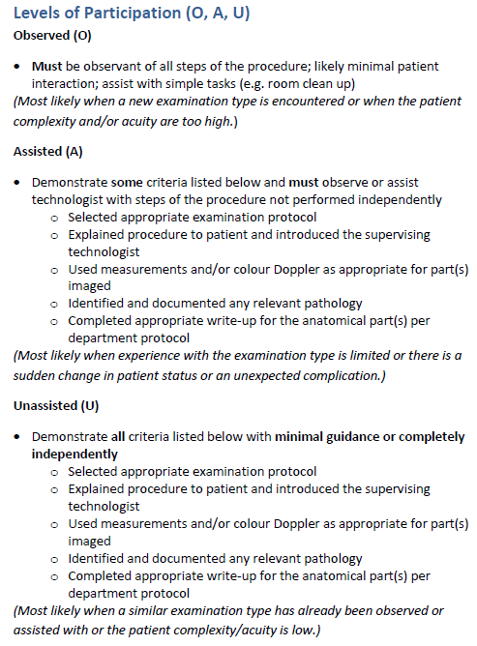
Levels of Participation
Students are already used to using this system to log their cases each day

Slide 14
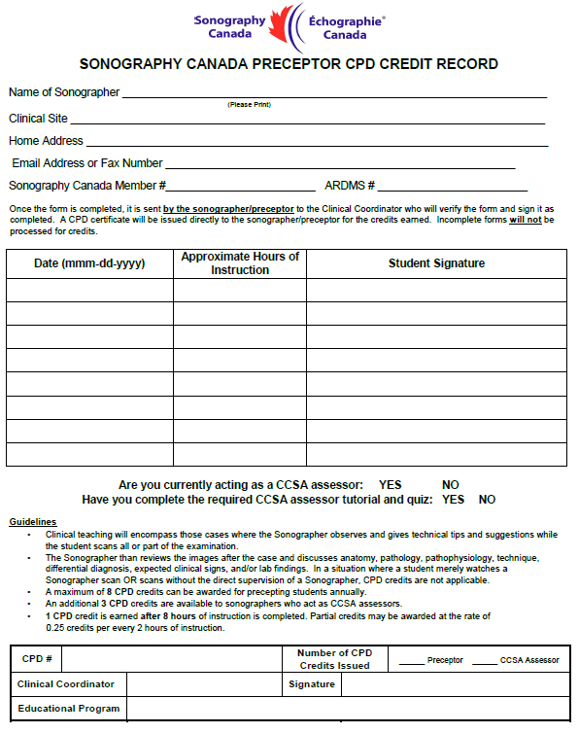
CPD Credits
1 CPD credit for 8 hours of instruction (basically one shift with a student)
Earn up to 8 CPD credits (ie. work with a student for 8 shifts, earn 8 CPD credits)
An additional 3 CPD credits are available if you are a CCSA assessor
Form can be found on MI Wiki under Ultrasound> US Continuing Education
Email the completed form to the Clinical Liaison for verification and we will send them back to you to submit for credits

Slide 15
Canadian Clinical Skills Assessments (CCSA’s)

Slide 16
CCSA’s
Assessors need to have completed the CCSA Assessor Tutorial on the Sonography Canada website
“The assessments should begin when both the assessor(s) and the candidate feel the candidate is able to consistently complete normal, abnormal, and technically difficult cases independently.”
The case must be selected before the assessment begins
There should be limited communication during the assessment between the assessor and candidate
Candidate MUST be under direct supervision
Students will be completing the Camosun Protocol (which very closely resembles the Island Health protocols)

Slide 17
CCSA’s
Completion includes; a thorough history, examination, and technical impression
“Imaging must be diagnostic. There may be room for improvement in terms of ideal windows and instrumentation, but imaging must demonstrate features that would allow for correct interpretation by a physician.”
Normal variants and common physiological findings are not considered abnormal findings (see the CCSA Manual in the Clinical Portfolio)
“Some minor findings may be missed by the candidate and the case not be a failure, if the candidate has completed a thorough/competent assessment. The abnormal findings missed cannot jeopardize the patient’s outcome.”

Slide 19
Preceptor Resources
https://intranet.islandhealth.ca/education/preceptor/Pages/default.aspx
  Island Health resources for preceptors
Island Health MI Wiki
  Jasmine has been working on making a folder for preceptor resources

Slide 20
Questions?
Comments?
Concerns?

